Slide 1

SUN POOL MANAGER
Group Anas:
Anas Alseid
Meena Alkhateeb
Yara Thahabi
Mohammad Musallam
Instructor:
Dr. Laith Shehab

Slide 2
Introduction to Sun Pool Manager
Smart pool:
The Smart Pool concept is not just an upgrade to swimming pools; it's a complete reimagining of how we interact with and maintain these leisure spaces.
Smart solar system:
Smart Solar Systems represent more than just an alternative energy source; they are a testament to how technology can be leveraged to make renewable energy more efficient, user-friendly, and adaptable

Slide 3
Problem-solving: (smart pool)
Water management:
Traditional Problem: Maintaining the right chemical balance in a pool and water. temperature.
Smart Pool Solution: Automated chemical monitoring and dispensing systems maintain optimal water quality and temperature.
Safety and security:
Traditional Problem: Swimming pools can be dangerous or not clean, especially for children and non-swimmers, without constant supervision.
Smart Pool Solution: Integration of motion sensors, detecting unexpected entry into the pool or identifying distressed swimmers, triggering alerts.

Slide 4
Problem-solving: (smart solar system)
Solar management:
Traditional problem: Solar panels in a conventional setup may not always operate at their maximum potential due to factors like shading, angle of the sun, and temperature fluctuations.
Solar system solution: Smart Solar Systems use technologies like Maximum Power Point Tracking (MPPT) and automated panel tilting to constantly adjust and optimize the angle and operation of solar panels for maximum efficiency throughout the day and across different seasons.

Slide 5
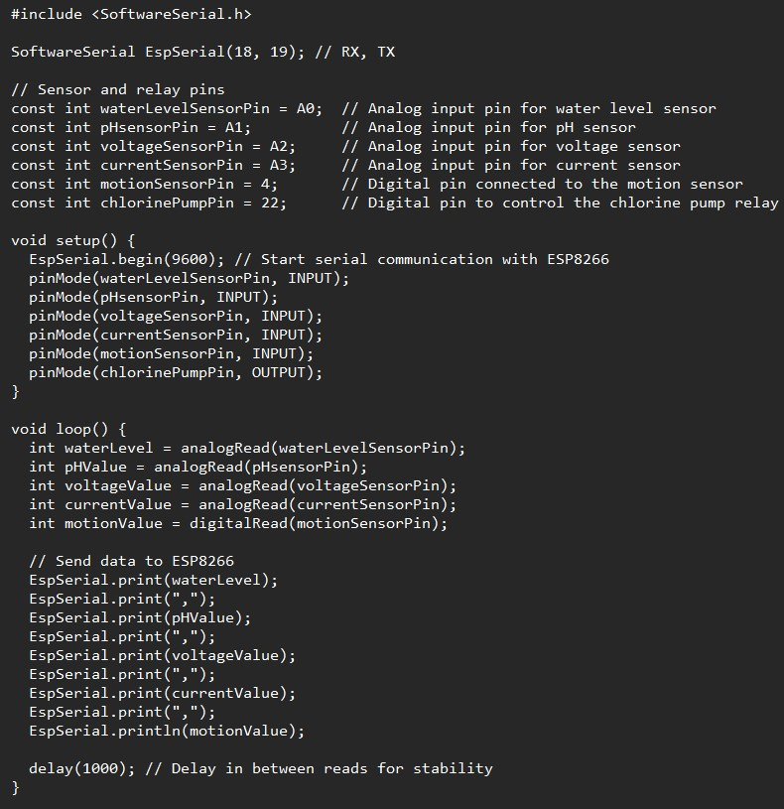
Code:
Arduino:
Arduino:

Slide 6
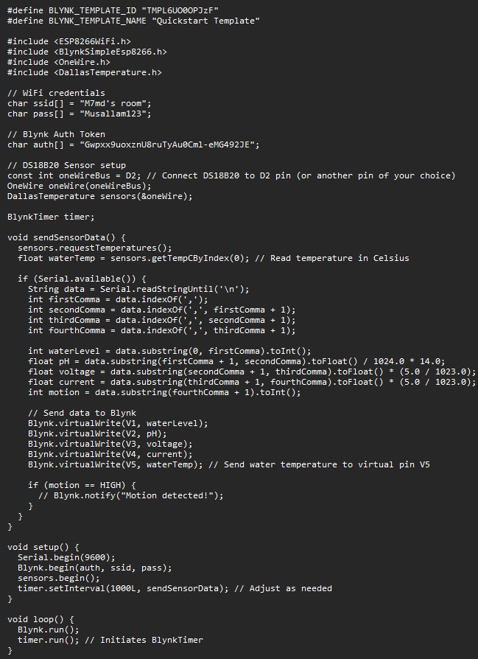
Code:
Wifi module:
Wifi module:

Slide 7
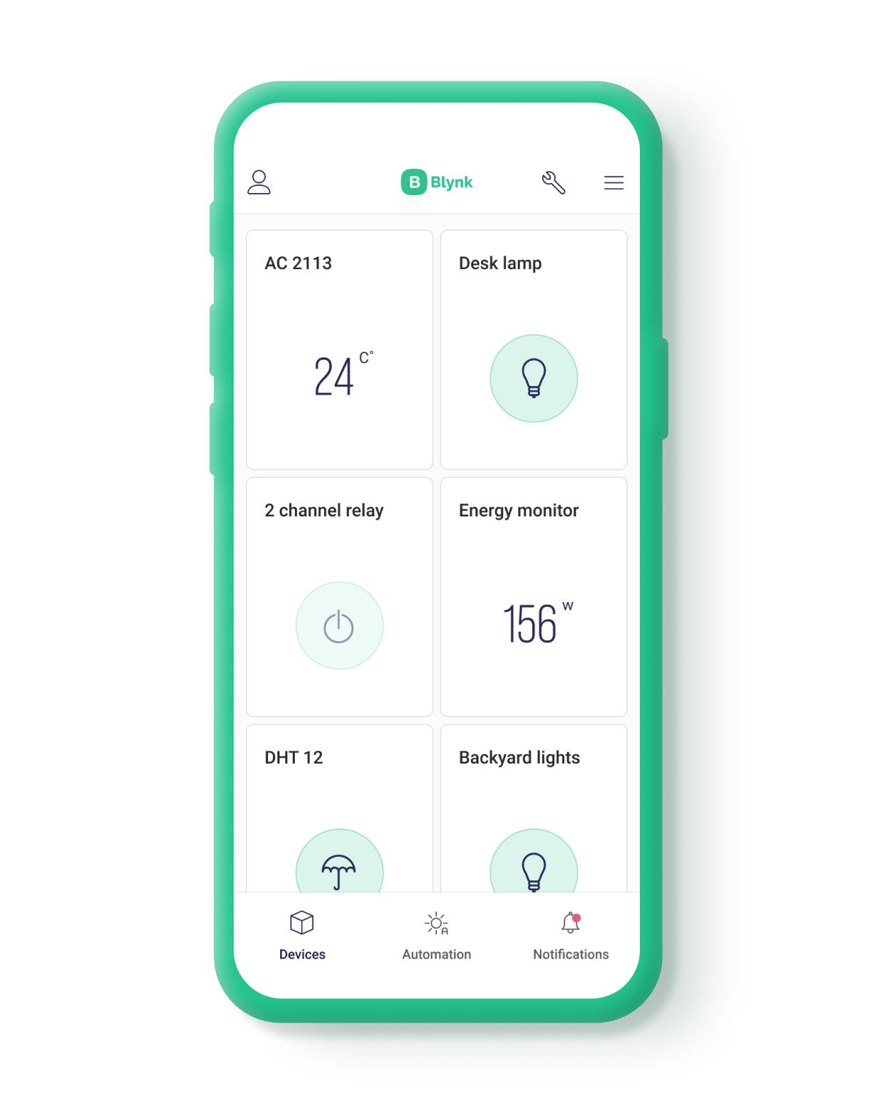
Blynk integration:
We are using Blynk to get notified on the phone , if there’s any problem with the water levels or pH and chlorine levels.
Also, to detect if there’s any objects gets in the pool while managing the water level, pH, and chlorine.
If there’s a change in the production of the solar panels a notification will be sent to Blynk.

Slide 8
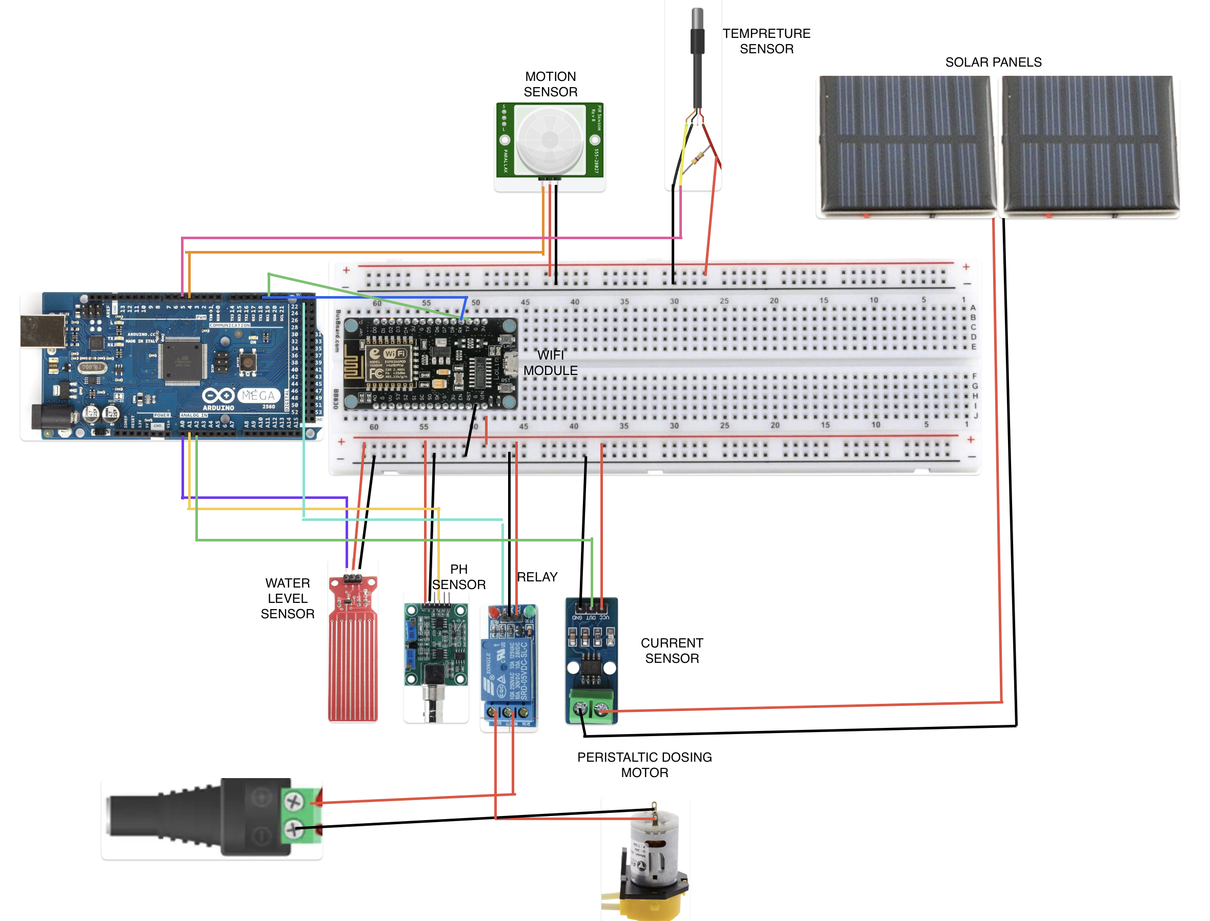

Diagram

Slide 9
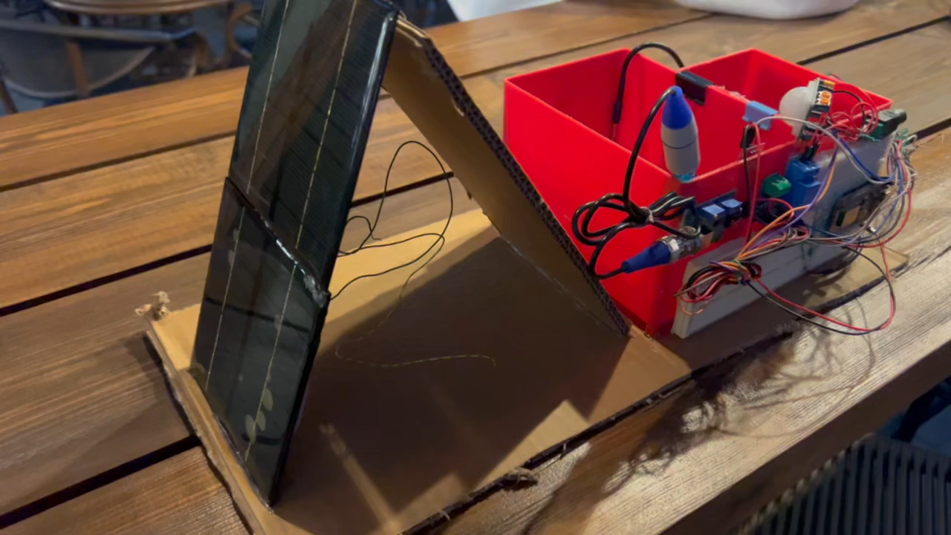
Prototype

